Slide 1
Disease intro

Slide 2
Learning intention: to explore different pathogens, focussing on bacteria
Success criteria:
List at least 3 of each category of pathogen
Describe and identify the four main shapes of bacteria
List structural properties of bacteria and describe why they may be useful

Slide 3
Definitions
Non-infectious diseases are caused by factors such as genetics, malnutrition, environment and lifestyle
Infectious diseases are caused by pathogens – such as bacteria, parasites, viruses or fungi
Contagious – can be passed from person to person via contact
Endemic - regularly found among particular people or in a certain area.
pathogens – things that cause infectious disease - such as bacteria, parasites, viruses or fungi

Slide 4
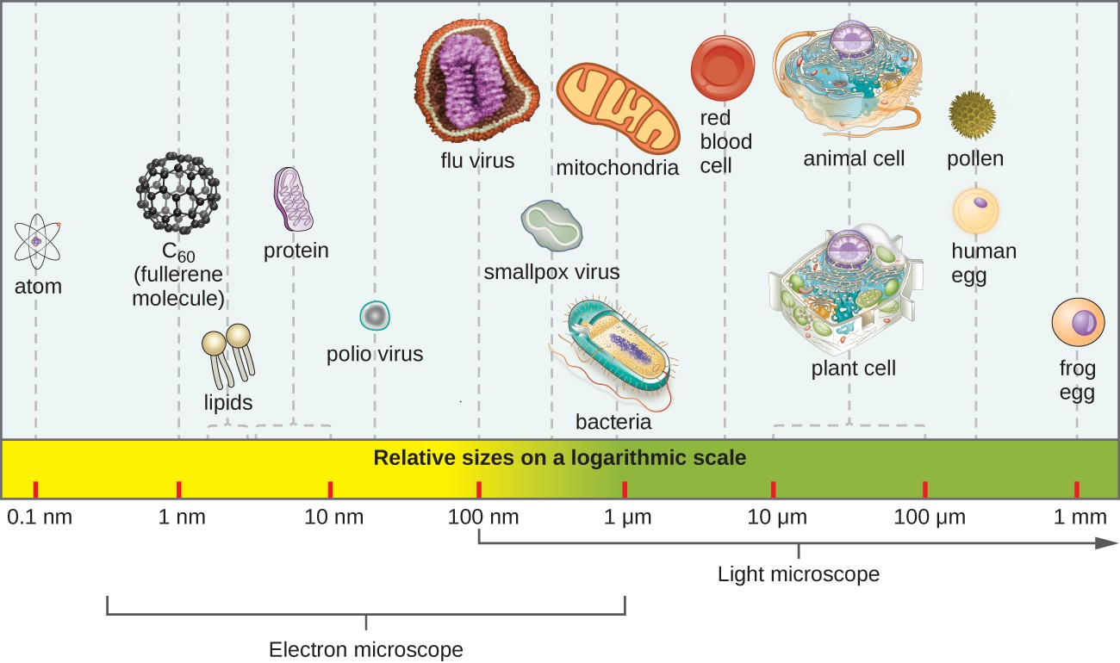

Slide 5
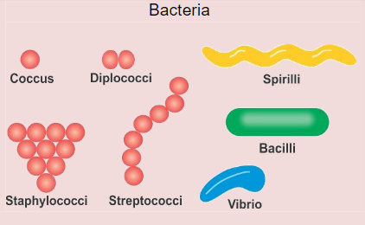

Slide 6
